Slide 1
Splunk Dashboards and Visualizations
SIEM Day 4
1

Slide 2

Class Objectives
By the end of class, you will be able to:
Create visualizations of single and multiple value searches.
Use the geostats and iplocation commands to add location-based visualizations to searches.
Combine multiple visualizations in a single dashboard.
Modify dashboards with time range input and drilldown capabilities.
2

Slide 3

visualizations
3

Slide 4

Today, we will expand our Splunk capabilities to include adding contextualized and informative visuals.
We will use these to analyze and research system and security issues.
4

Slide 5
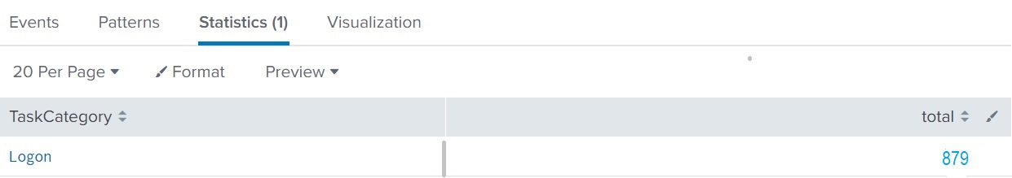
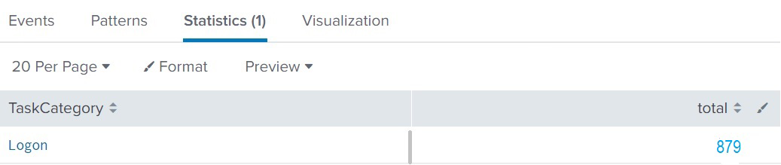
Contextualizing Data
The following table displays the the number of logins per minute into a web application:
Number of logins per minute
5

Slide 6
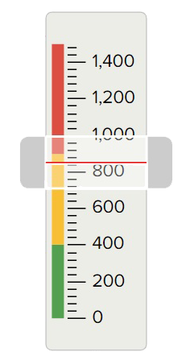
The gauge visualization contextualizes that number by including the severity of the login count.
6

Slide 7
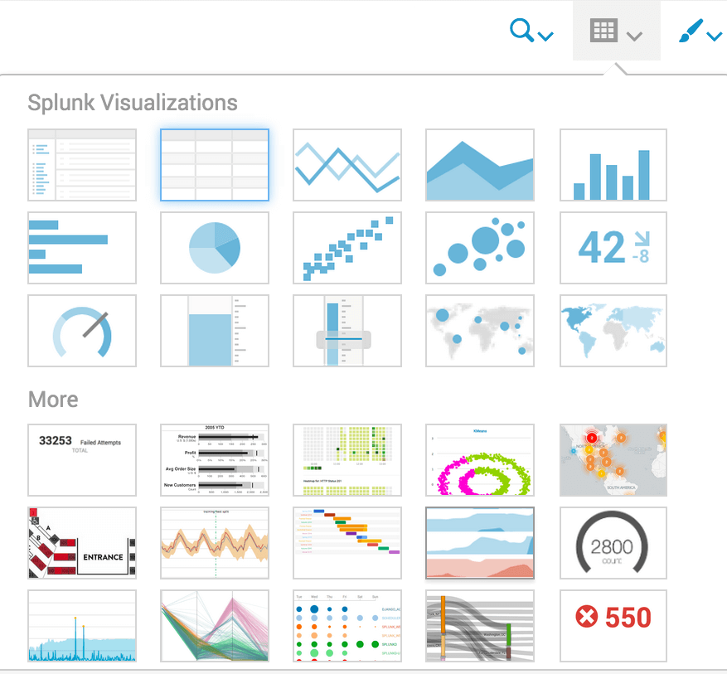
Splunk uses visualizations
to make complex data easier
to understand and analyze.
7

Slide 8
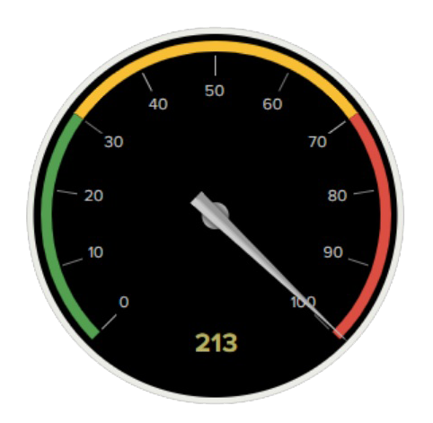
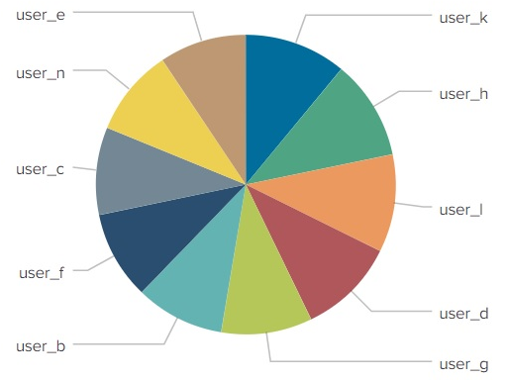
Splunk Visualizations
Splunk visualizations can display single values, such as total count of attacks, and multiple values, such as a chart of attacks correlated by attack type.
Single Value Visualizations
Multiple Value Visualizations
8

Slide 9
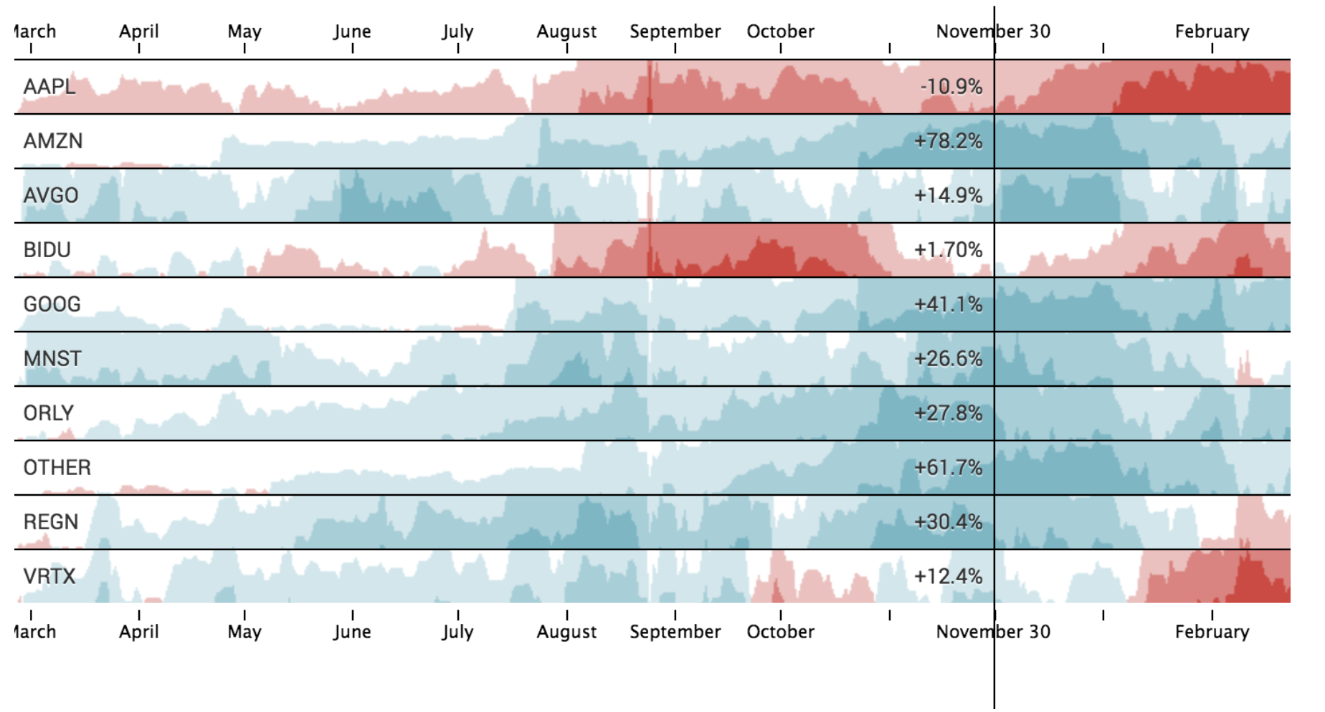
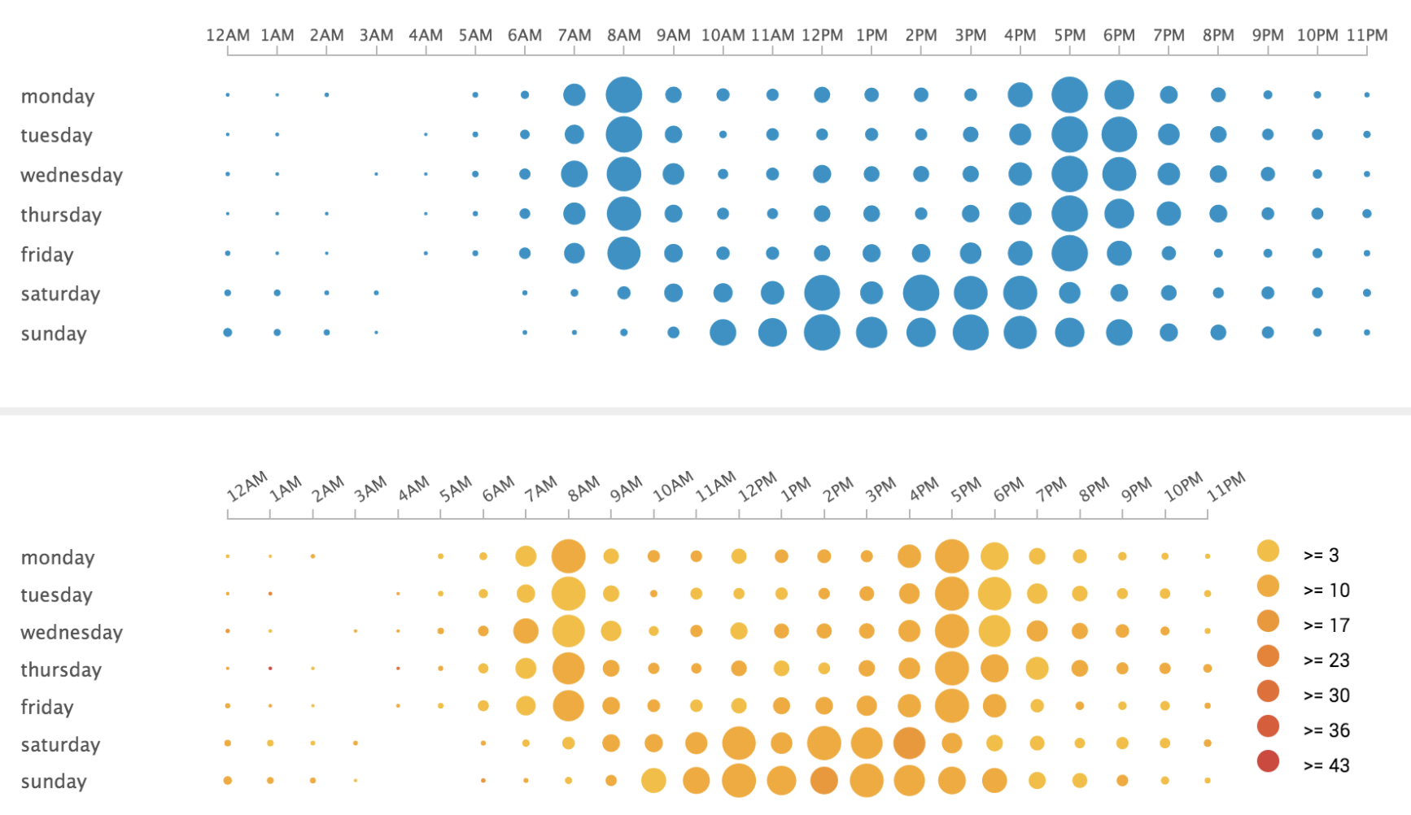
Splunk Visualizations
Splunk visualizations allow interactivity and offer more in-depth details.
These range from simple bar and column charts to complex horizon charts and punchcards.
Horizon chart
Punchcard
(Horizon Chart)
(Punchcard)
9

Slide 10
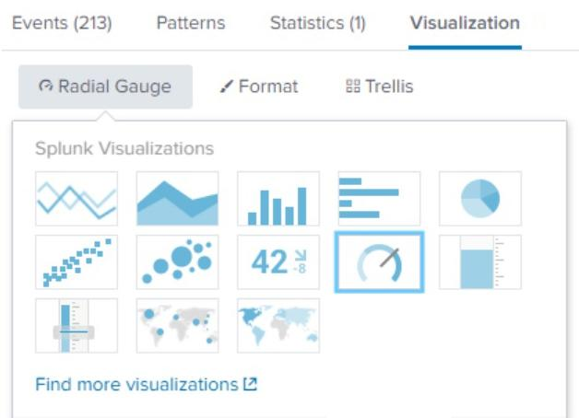

Single Value Visualizations
In the first demonstration, we will use a single value to create a radial gauge visualization.
Radial gauges are similar to the RPM dial found in the dashboard of a car.
RPM (revolutions per minute) is a single value visualized in the dial.
The dial includes a red section that indicates when the level is too high.
10

Slide 11
Single Value Visualization
11

Slide 12
Activity: Single Value Visualizations
In this activity, you will design a single value radial gauge to assist with monitoring attacks against your website.
15 Minutes
12

Slide 13
13

Slide 14
Now, we will visualize multiple values.
14

Slide 15
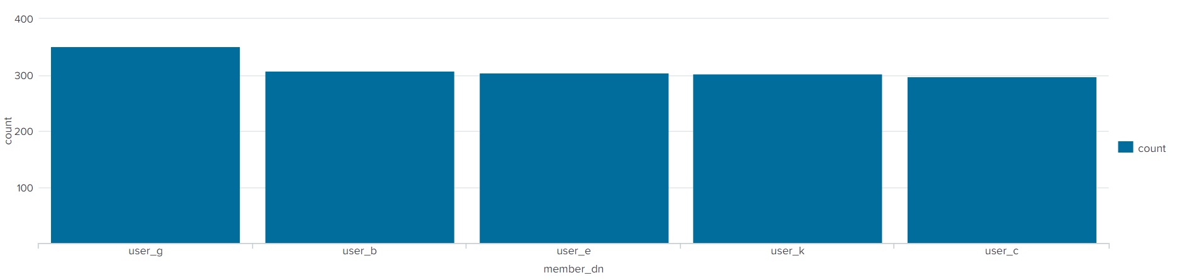
Multiple Values Visualization
Suppose a business is experiencing brute force attacks against a web application. They want want to visualize the list of users being attacked and the number of attacks experienced by each user.
We can convert Splunk stat spreadsheets into more informative and interactive visualizations:
15

Slide 16
Multiple Value Visualization
16

Slide 17
Activity: Multiple Value Visualizations
In this activity, you will design a multiple value visualization to display the URL paths being targeted by the POST requests.
15 Minutes
17

Slide 18
18

Slide 19
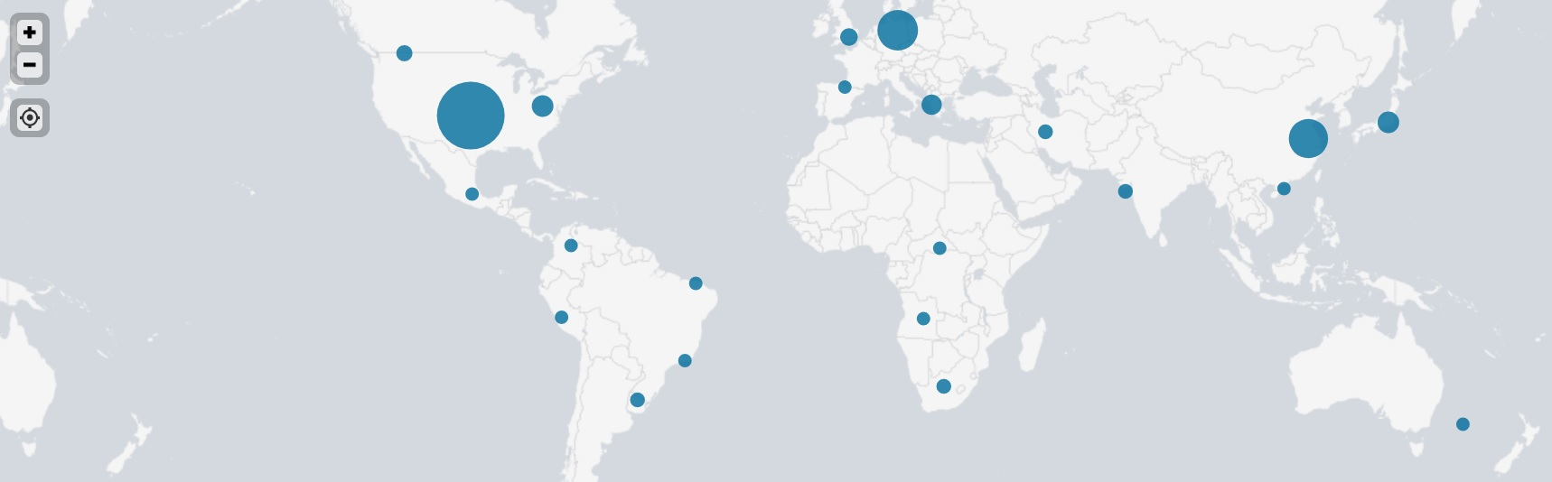
Geographic Map Visualization
Organizations can monitor where users access their application from to help determine the source of security issues.
For example
A business knows that their application customers are primarily located in the United States.
If they find out a significant number of users have started accessing their application from somewhere else, they will take this as a cue to investigate the activity.
19

Slide 20
Geographic Map Visualization
To create these maps and gain more insight into the locations of activity, we will use the following commands:
01
The iplocation command
will output the city and country data of an IP field, such as src_ip or dest_ip.
sourcetype="stream:http" | iplocation src_ip
02
The geostats command
uses the location data found with the iplocation command to map latitude and longitude data for each event.
sourcetype="stream:http" | iplocation src_ip | geostats count

Slide 21
Geographic Map Visualization
21

Slide 22
Activity: Geographic Map Visualizations
In this activity, you will design a geographic map visualization to help your SOC team understand where attacks are originating.
15 Minutes
22

Slide 23
23

Slide 24
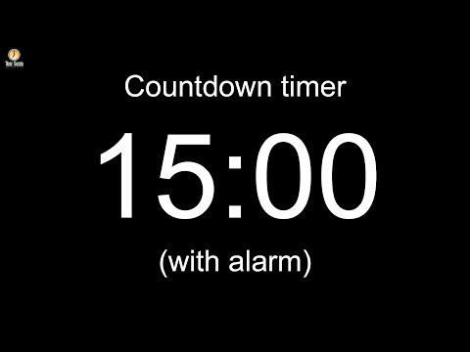
24
Notes:
Image source: AdobeStock_56885471
Break

Slide 25
dashboards
25

Slide 26
While the visualizations we’ve covered so far are useful on their own, they are even more effective when grouped and displayed together.
26

Slide 27
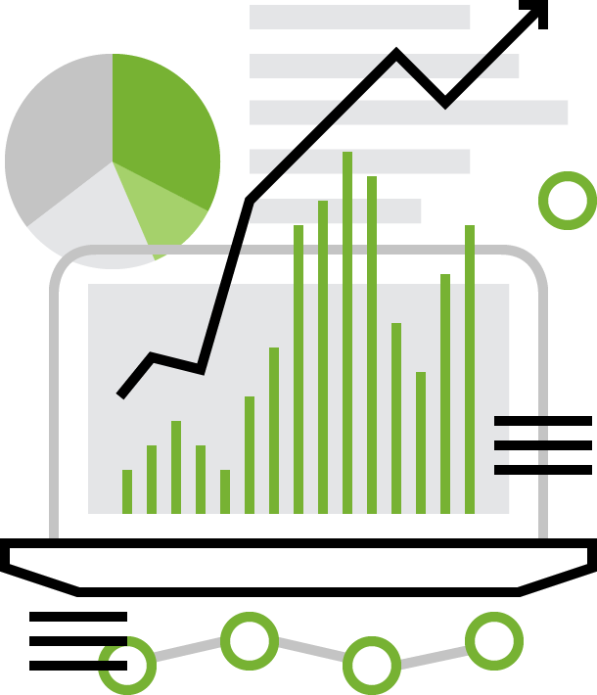
Dashboards
For example, an organization that is monitoring a website may want to display all of the following at the same time:
01
The volume of successful logins on the website.
02
The volume of unsuccessful logins on the website.
03
A geographic map illustrating where the activity is coming from.
04
A pie chart displaying the specific pages of the website that are being accessed.
Notes:
shutterstock_520092895

Slide 28

Dashboards
Displaying all this information together can provide a security analyst with a complete picture of the state of their web application.
(Source)
28

Slide 29

Dashboards are a collection of multiple visualizations in a single location.
29

Slide 30
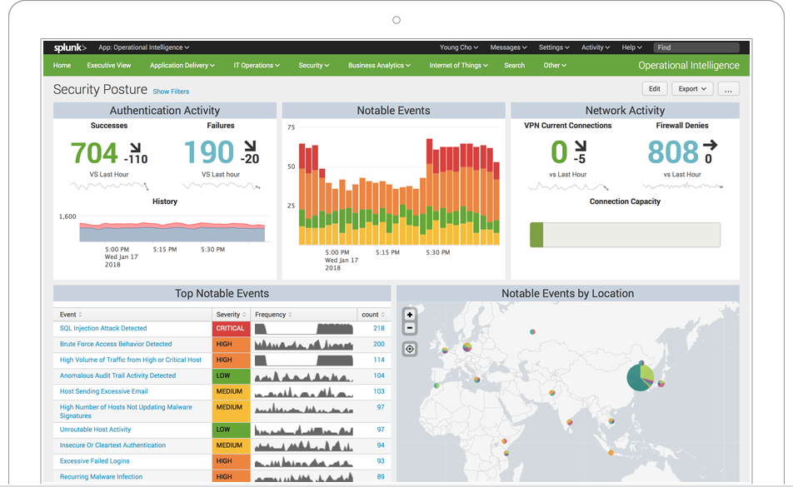
Dashboards
The visualizations are placed in different sections, called panels.
(Splunk.com)

Slide 31
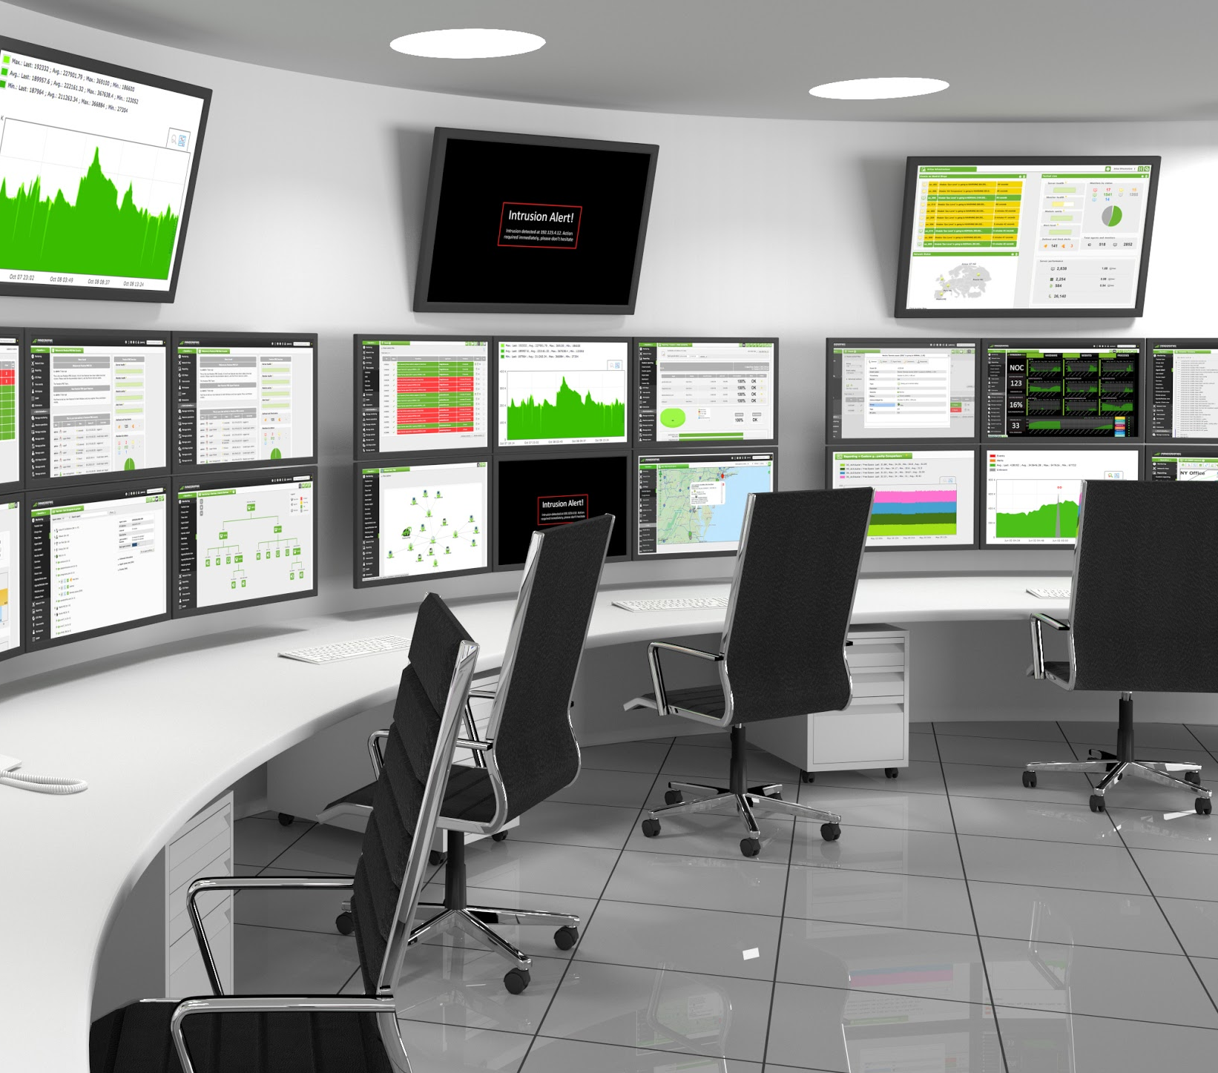
SOCs often have dashboards displayed on multiple screens in their operations room to provide availability and functionality across their staff.
31
Notes:
shutterstock_294087938

Slide 32
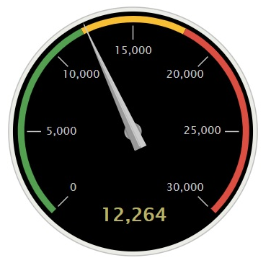
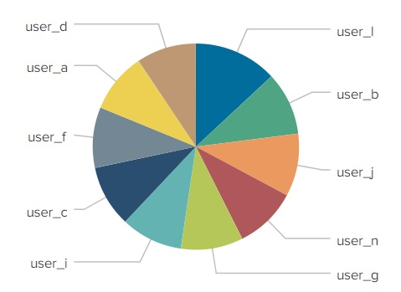
Dashboard Demo Scenario
As a SOC manager, you would like to create a single three-panel dashboard to monitor your Windows server. You want the panels to include:
01
A radial gauge of successful logins.
Windows Monitoring Dashboard
Windows Login Count
Top 10 Windows Users
02
A pie chart of users logging in.
03
A statistical chart of the data in the pie chart.
Windows Users Login
user
count
user_1
936
user
710
32

Slide 33
Creating Dashboards
33

Slide 34
Activity: Creating Dashboards
In this activity, you will design a dashboard to view all of the visualizations we’ve made, in a single location.
15 Minutes
34

Slide 35
35

Slide 36
Next, we’ll take these dashboards a step further by adding drilldowns and interactivity.
36

Slide 37


Dashboard Drilldowns and Interactivity
We will go through how to configure these features by using the dashboard and scenario from the last demonstration.
As a SOC manager, you created a three-panel dashboard to monitor your Windows server.
You will expand the functionality of this dashboard by:
Modifying the date and time ranges being analyzed directly on the dashboard.
Adding a drilldown into the visualizations to assist with further analysis.
37
Notes:
shutterstock_1160775805

Slide 38
Dashboard Drilldowns and Interactivity

Slide 39
Activity: Advanced Dashboards
In this activity, you will enhance your dashboard by adding drilldowns and interactivity features.
0:15
39

Slide 40
40

